Slide 1
Relational Database Model
Module 6
Prepared by: Engr. Ryan D. Francisco

Slide 2
A Logical View of Data
Relational model
View data logically rather than physically
Table
Structural and data independence
Resembles a file conceptually
Relational database model is easier to understand than hierarchical and network models

Slide 3
Tables and Their Characteristics
Logical view of relational database is based on relation
Relation thought of as a table
Table: two-dimensional structure composed of rows and columns
Persistent representation of logical relation
Contains group of related entities (entity set)

Slide 4
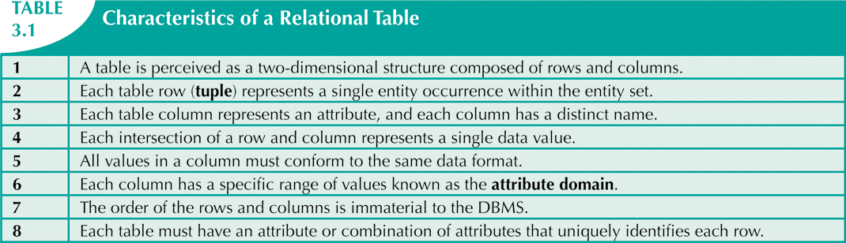

Slide 5
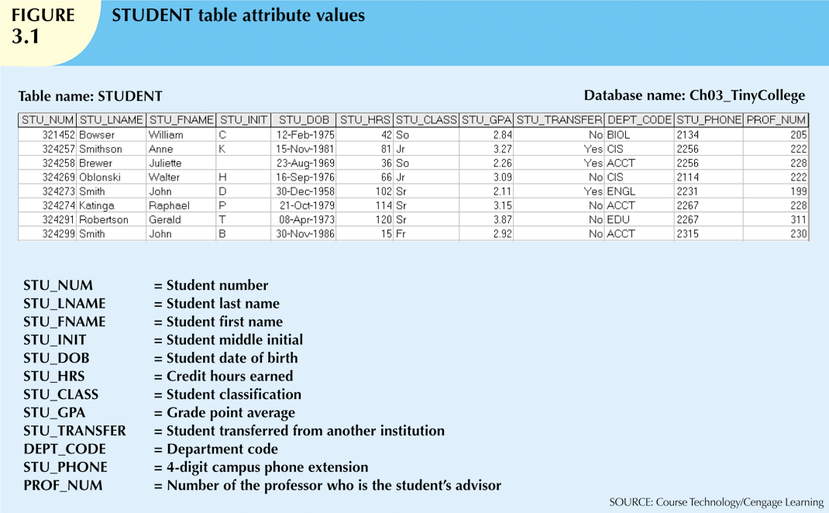

Slide 6
Keys
Each row in a table must be uniquely identifiable
Key: one or more attributes that determine other attributes
Functional dependence
Attribute B is functionally dependent on A if all rows in table that agree in value for A also agree in value for B

Slide 7
Types of Keys
Composite key
Composed of more than one attribute
Key attribute
Any attribute that is part of a key
Superkey
Any key that uniquely identifies each row
Candidate key
A superkey without unnecessary attributes

Slide 8
Types of Keys (cont’d.)
Nulls
No data entry
Not permitted in primary key
Should be avoided in other attributes
Can represent:
An unknown attribute value
A known, but missing, attribute value
A “not applicable” condition
Can create problems when functions such as COUNT, AVERAGE, and SUM are used
Can create logical problems when relational tables are linked

Slide 9
Types of Keys (cont’d.)
Controlled redundancy
Makes the relational database work
Tables within the database share common attributes
Enables tables to be linked together
Multiple occurrences of values not redundant when required to make the relationship work
Redundancy exists only when there is unnecessary duplication of attribute values

Slide 10
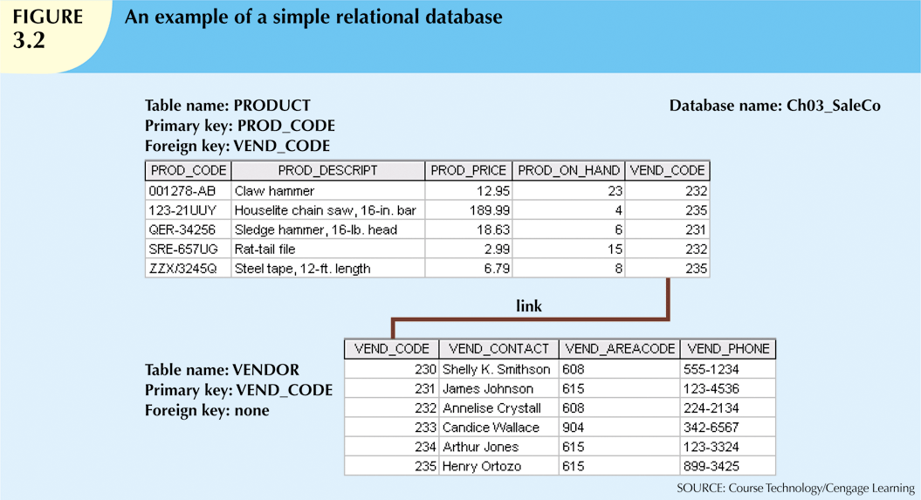

Slide 11
Types of Keys (cont’d.)
Foreign key (FK)
An attribute whose values match primary key values in the related table
Referential integrity
FK contains a value that refers to an existing valid tuple (row) in another relation
Secondary key
Key used strictly for data retrieval purposes

Slide 12
Integrity Rules
Many RDBMs enforce integrity rules automatically
Safer to ensure that application design conforms to entity and referential integrity rules
Designers use flags to avoid nulls
Flags indicate absence of some value

Slide 13
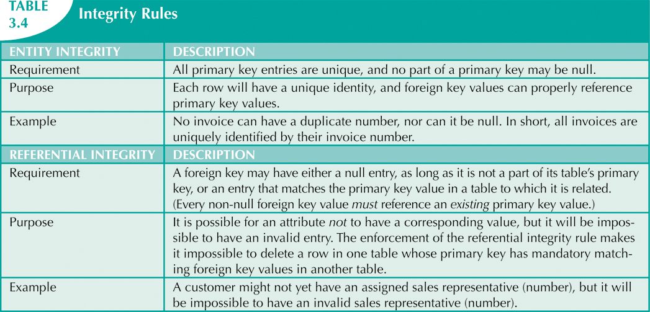

Slide 14
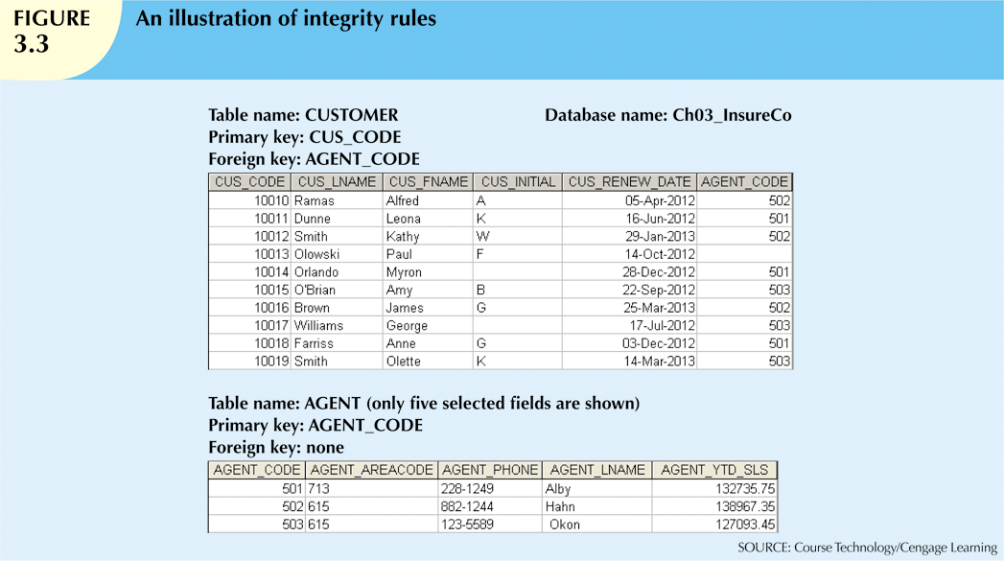

Slide 15
Relational Set Operators
Relational algebra
Defines theoretical way of manipulating table contents using relational operators
Use of relational algebra operators on existing relations produces new relations:
SELECT | UNION
PROJECT | DIFFERENCE
JOIN | PRODUCT
INTERSECT | DIVIDE

Slide 16
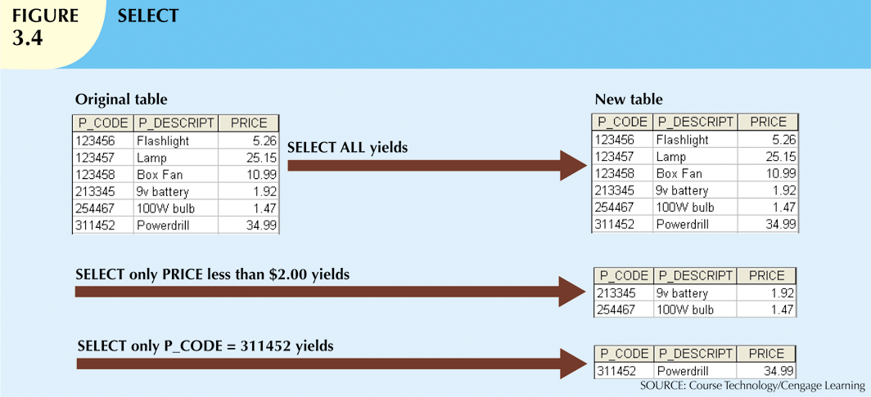

Slide 17
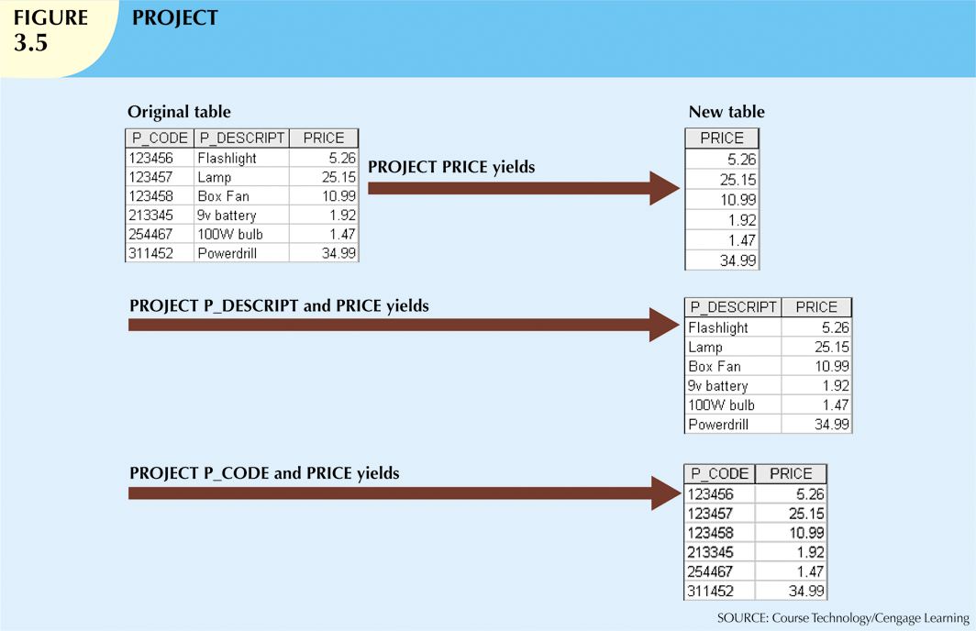

Slide 18
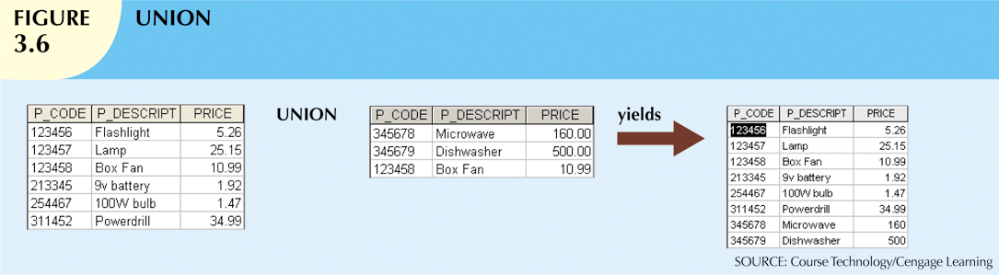
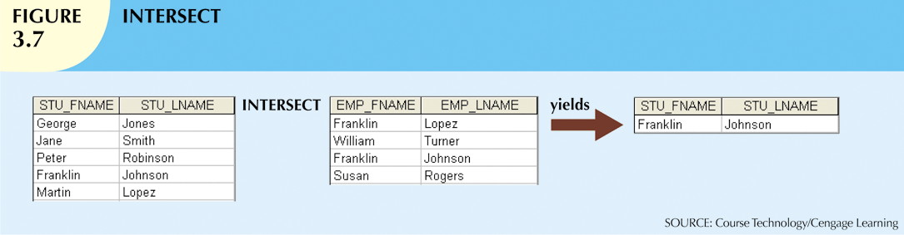

Slide 19
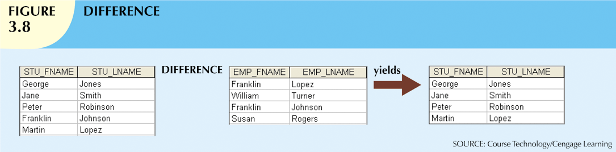
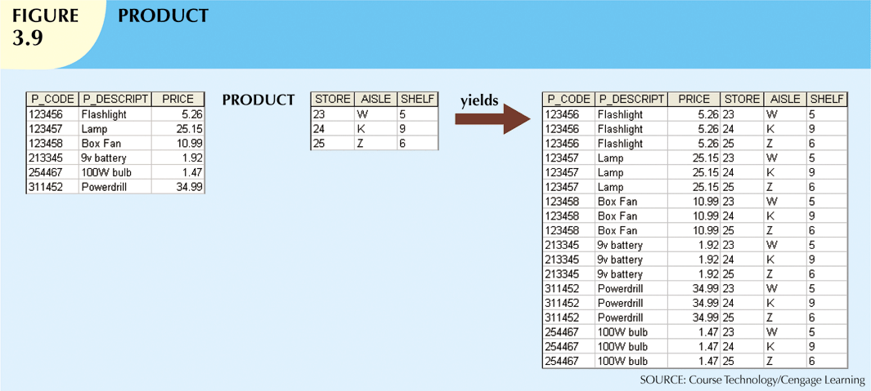

Slide 20
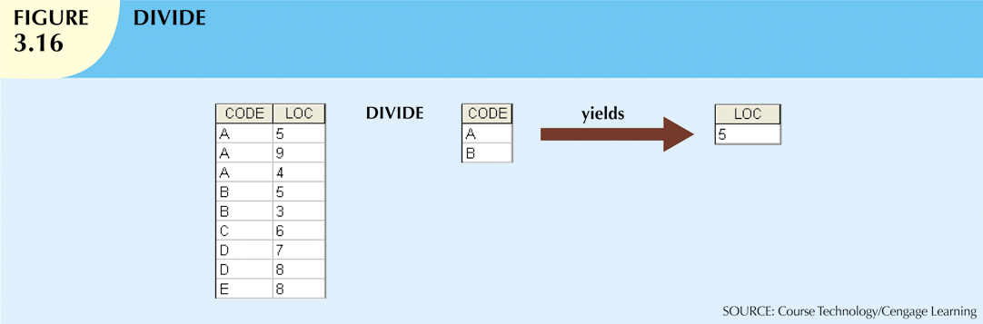

Slide 21
Relational Set Operators (cont’d.)
Natural join
Links tables by selecting rows with common values in common attributes (join columns)
Equijoin
Links tables on the basis of an equality condition that compares specified columns
Theta join
Any other comparison operator is used

Slide 22
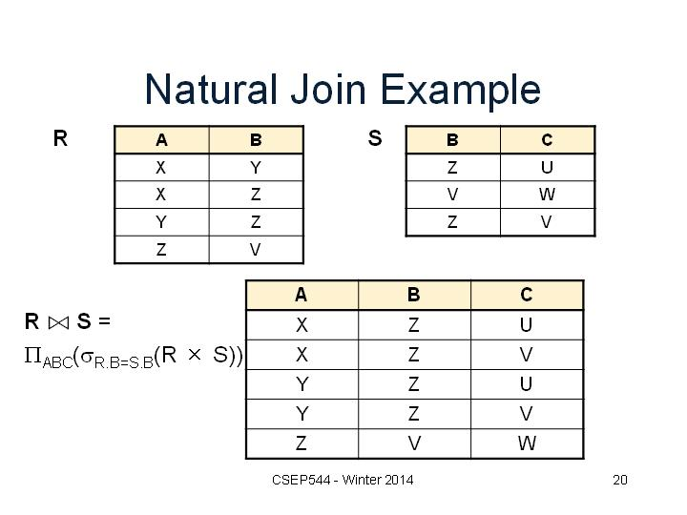

Slide 23
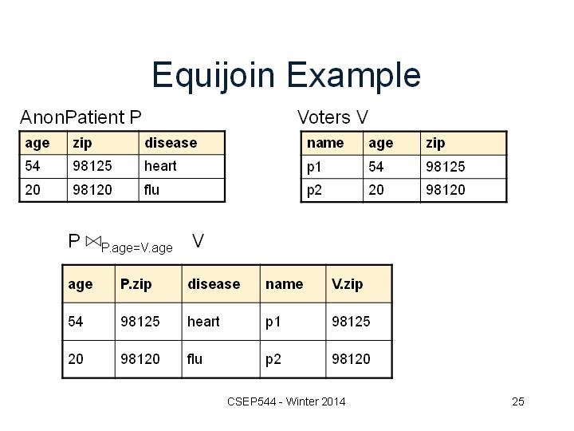

Slide 24
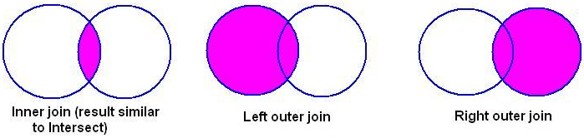
Relational Set Operators (cont’d.)
Inner join
Only returns matched records from the tables that are being joined
Outer join
Matched pairs are retained, and any unmatched values in other table are left null

Slide 25
Relational Set Operators (cont’d.)
Left outer join
Yields all of the rows in the CUSTOMER table
Including those that do not have a matching value in the AGENT table
Right outer join
Yields all of the rows in the AGENT table
Including those that do not have matching values in the CUSTOMER table

Slide 26
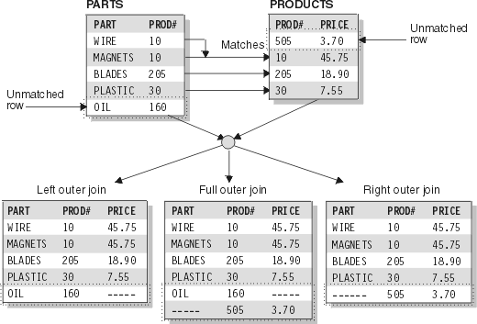

Slide 27
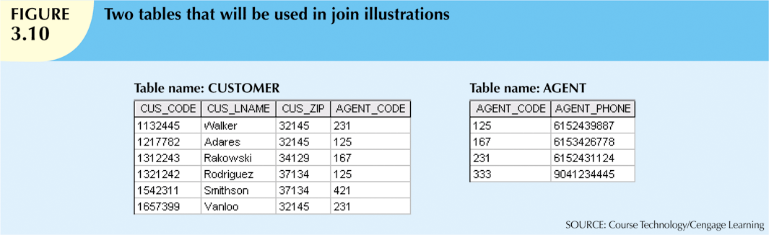

Slide 28
The Data Dictionary and System Catalog
Data dictionary
Provides detailed accounting of all tables found within the user/designer-created database
Contains (at least) all the attribute names and characteristics for each table in the system
Contains metadata: data about data
System catalog
Contains metadata
Detailed system data dictionary that describes all objects within the database

Slide 29
